Slide 1


SWP391 Final Presentation
Supervisor
Nguyễn Minh Sang
Team Sử Việt
Nguyễn Trung Tín (Leader)
Dương Thị Trúc Linh
Lê Công Sơn
Nguyễn Quốc Nhân
Nguyễn Tuấn Vũ

Slide 2
Table of Contents
Project Introduction
System Architectural Overview
Actor & Feature
Demonstration
Outcomes
Q & A

Slide 3
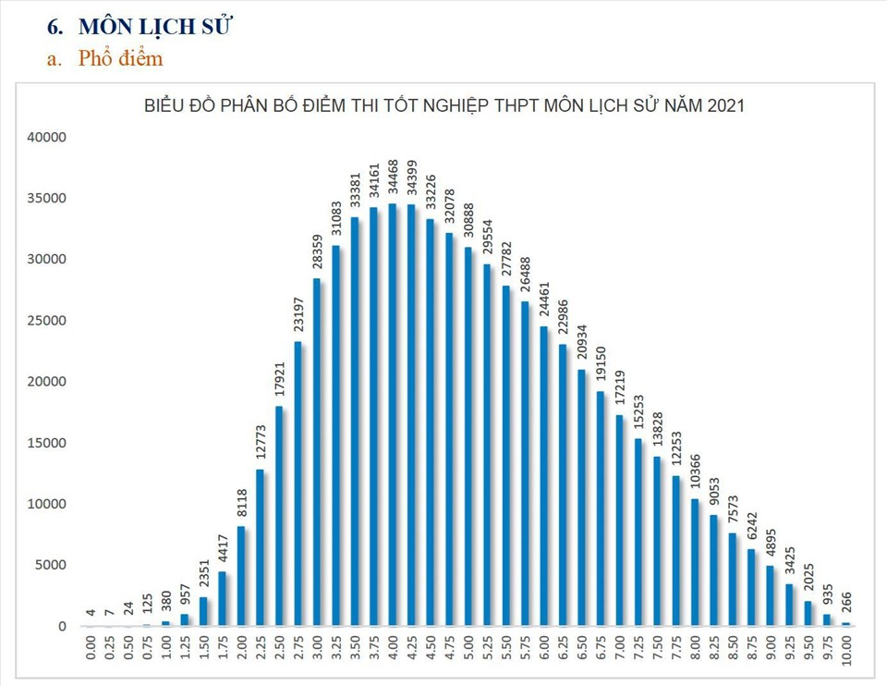

1. Project Introduction | Context & Problem

Slide 4



Slide 5




1. Project Introduction | Proposed & Solution
Censorship
Research
MODERATOR
Guest
Post and discuss
Administration
Member
ADMIN

Slide 6











2. System Architectural Overview
Frontend
Backend
API Layer
RestController
Business Logic
Layer
Data Access
Layer
Technologies
Frontend ReactJS Bootstrap 5 Figma | Backend Spring Boot JWT Microsoft SQL Server RESTful API Postman Tomcat
Other Applications

Slide 7
3. Actor & Feature
Guest
Member
MODERATOR
ADMIN
Research
Research
Post article, comments
Research
Management Resource (articles, comments, books,..)
Research
Management Resource (articles, comments, books,..)
Management users

Slide 8
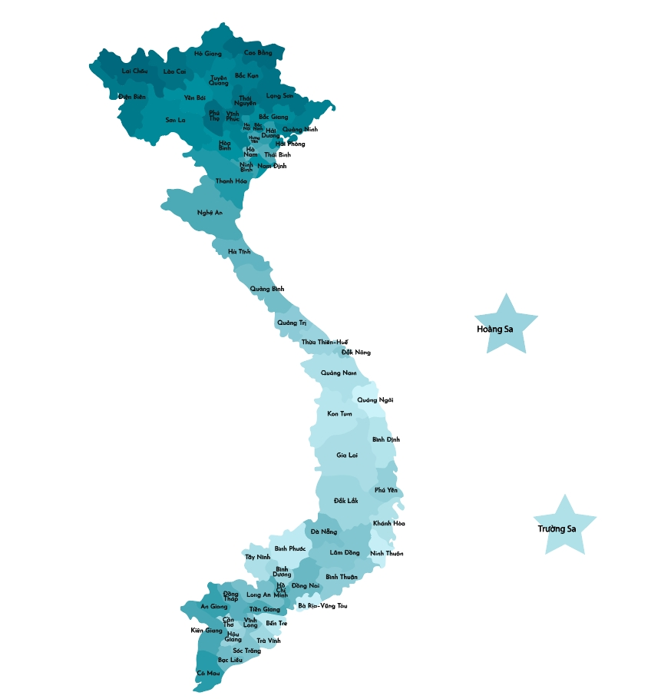

4. Demonstration
Scenario #1: Map Interactives
1. Open web
2. View map and manipulate based on provinces
User

Slide 9
Scenario #2: Guest (Whole operations)
1. Nhân vật
2. Di tích
3. Di vật - cổ vật
4. Video
5. Sách
6. Bài viết
1. Chi tiết về Nhân vật
2. Chi tiết về Di tích
3. Chi tiết về Di vật - cổ vật
4. Chi tiết về Video
5. Chi tiết về Sách
6. Chi tiết về Bài viết
1. Open web
2. Visit
3. Read
User
Timeline

Slide 10
Scenario #3: Article’s Features + Moderator’s Features
Post and discuss
Censorship
Member
MODERATOR

Slide 11
Scenario #4: Registration + Upload Profile

Slide 12
Scenario #5: Admin’s Feature

Slide 13
5. Outcomes
Lessons Learned
First made separately between Frontend and Backend.
Experience self-learning new technology and parallel learning new knowledge and apply it to projects
Teamwork
Time management
Project management
Application Achievements
A web app for research and discus about Vietnam’s History
Get inspired with interactive map

Slide 14
5. Outcomes
Project Deliverables
Source code: https://github.com/golden-egghead/project-swp-suviet
API Management: Postman
Document:
Limitation
Incomplete information and some information has not been recognized so it is not included
Some features are incomplete due to not clearly planned

Slide 15
Thank You For Your Listening
Q & A

